Slide 1
BUSINESS INTELLIGENCE
(INTRODUCTION)
(#2)
Prof. Dr. Ercan Oztemel

Slide 2
CONTENTS…
Why BI
Changing Business Environment and Decision Support Systems
Basic Definition
Main Trend
BI Technologies
Predictive Analytics
Text Analytics
Visualization/Dashboards
Master Data Management
The Cloud
Analytic Databases
Mobile BI
Open Source
Artificial intelligence Technologies (intelligent Decision Making Technologies)

Slide 3
Why Does an Enterprise Use BI?
Finding out the problems caused by the old information systems
Satisfying the information needs of managers for better decision making
Relating the problems to the supply chain (from factories, to dealers, to consumers).
Identifying the strategic advantage derived from the data available
Generating consumer-helping robots, autonom decision making systems to the changing business environment.
Closing the gap between the current performance of an organization and its desired performance as expressed in its mission, objectives, and goals and helping facilitate the strategy for achieving them
Supporting the generation of quick response to changing Business environment
…

Slide 4
Changing Business Environments and Computerized Decision Support
Everything is changing except the change itself.
The business environment is dynamic,
Organizational responses to be, anticipative, adaptive, and proactive.
Computerized support is inevitable.
Decision support Systems
Intelligent Systems

Slide 5
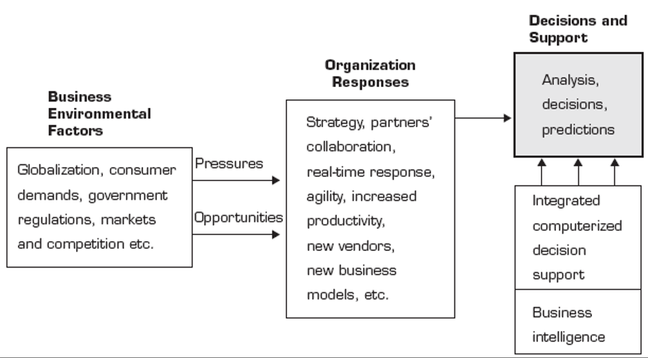
Changing Business Environments and Computerized Decision Support

Slide 6
Why is Business Intelligence So Important?
Time
Data
Opinion
(Best Professional Judgment)
Making Business Decisions is a Balance
In the absence of data, business decisions are often made by the HiPPO (– the moment when the “Highest Paid Person’s Opinion” is asserted as fact and intended to be directional.)
With Business Intelligence, we can get data to you in a timely manner.

Slide 7
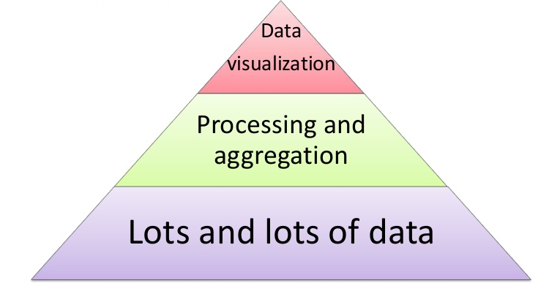
What is BI?
Business intelligence (BI) is a set of theories, methodologies, architectures, and technologies that transform raw data into meaningful and useful information for business purposes.
in other words;
BI is to extract the information deemed central to the business, and to present or manipulate that data into information that is useful for managerial decision support

Slide 8
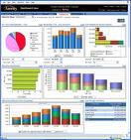


What is Business Intelligence?
Business Intelligence enables the business to make intelligent, fact-based decisions
Aggregate Data
Present
Data
Enrich
Data
Inform a Decision
Databases, Data Warehouse,
Reporting Tools, Dashboards, Static Reports, Mobile Reporting, OLAP Cubes
Add Context to Create Information, Descriptive Statistics, Benchmarks,
Decisions are Fact-based and Data-driven

Slide 9
A Framework for Business Intelligence…
BI is a conceptual framework for decision support. It combines architecture, databases (or data warehouse), analytical tools and applications
The term business analytics (BA) are also defined as to include the access, reporting, and analysis of data supported by software to drive business performance and decision making
BA and BI are the essentially the same thing or supplement to each.

Slide 10
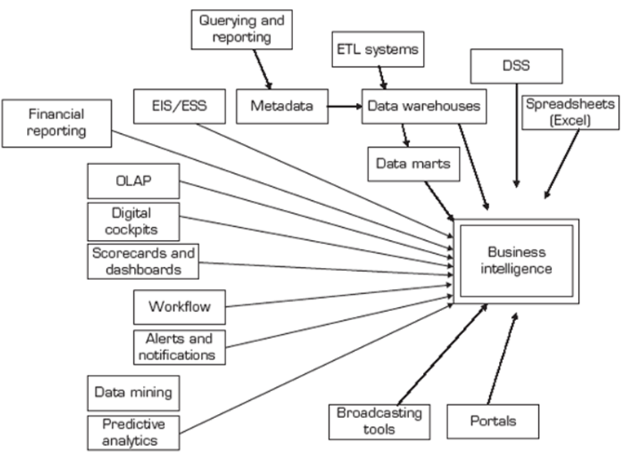
A Framework for Business Intelligence…

Slide 11
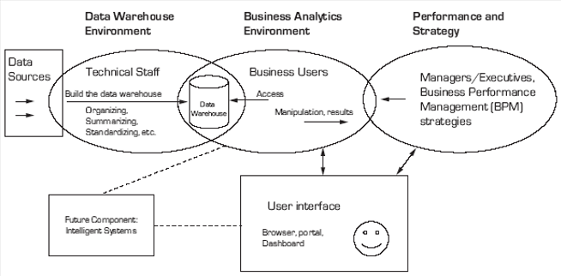
A Framework for Business Intelligence (components)…

Slide 12
BI Technologies
Predictive Analytics
Text Analytics
Analytic Databases
Visualization/Dashboards
Master Data Management
The Cloud
Mobile BI
Artificial intelligence Technologies (intelligent Decision Making Technologies)

Slide 13
Predictive Analytics
Data Mining
Regression
Simulation ( i.e. monte carlo)
Statistical analysis
Example:
Predicting Customer Behavior
Satisfaction/loyalty
Purchases
Profiles/Business performance

Slide 14
Example: Retail Analytics
Customer Segmentation/Clustering
Tailored Product Assortments
Inventory Forecasting
Market Basket Analytics
…

Slide 15

Amazon.com and NetFlix
Collaborative Filtering tries to predict other items a customer may want to purchase based on what’s in their shopping cart and the purchasing behaviors of other customers

Slide 16
Text Analytics…
…turning unstructured customer comments into actionable insights
…finding basic insights within text data that will improve the business
From Wikipedia:
… a set of linguistic, statistical, and machine learning techniques that model and structure the information content of textual sources for business intelligence, exploratory data analysis, research, or investigation

Slide 17


Text Processing Process…
Facebook Page
Twitter
Page
Customer Sat Survey Comments
Call
Center
Notes,
Voice
Services
Quality
Cost
Friendliness
Competitors’ Facebook
Pages
Public Web Sites,
Discussion Boards, Product Reviews
Email
Blogs
Alerts,
Real-time Action
Adhoc Feedback

Slide 18
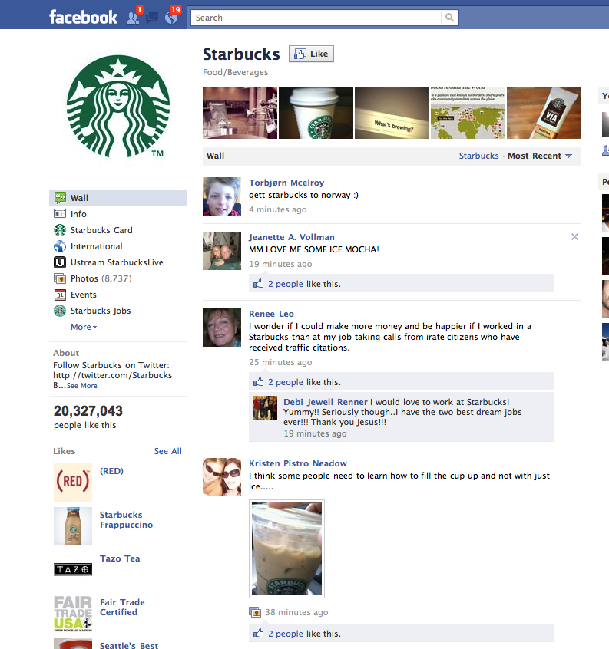

Slide 19
Analytic Databases
BI is a consolidating industry
Oracle: Siebel, Hyperion, Brio, Sun
SAP: Business Objects, Sybase
IBM: Cognos, SPSS, Coremetrics, Unica, Netezza
EMC: Greenplum
HP: Vertica
Teradata: Aster Data
Independent vendors: MicroStrategy, Informatica, SAS
Reporting standards determined mainly by Microsoft, Apple and Adobe
DB2
Oracle
SQL Server
Teradata
Netezza
Vertica
Aster Data
Par Accel
Greenplum
Semantic Databases
(TIDE)

Slide 20
Semantic Data Model and Semantic Databases…
Semantic Data Model (SDM), is a way of structuring data to represent it in a logical way. It focuses on providing more meaning of the data itself, rather than solely or primarily on the relationships and attributes of the data
Semantic databases offer five main benefits:
They work with your existing relational databases.
They align with Web technologies.
Their underlying technology speeds integration of multiple databases.
They're based on data structures that are flexible by design. And thus;
They can help enterprises tackle big data challenges.

Slide 21
Visualization/Dashboards
Data visualization is to communicate information clearly and efficiently via statistical graphics, plots and information graphics.
Numerical data may be encoded using dots, lines, or bars, to visually communicate a quantitative message.
Effective visualization helps users analyze and reason about data and related evidence.
It makes complex data more accessible, understandable and usable.
Users may have particular analytical tasks, such as making comparisons or understanding causality, and the design principle of the graphic (i.e., showing comparisons or showing causality) follows the task.
Tables are generally used where users will look up a specific measurement, while charts of various types are used to show patterns or relationships in the data for one or more variables.
Dashboards: A visual presentation of critical data for executives to view. It allows executives to see hot spots in seconds and explore the situation

Slide 22
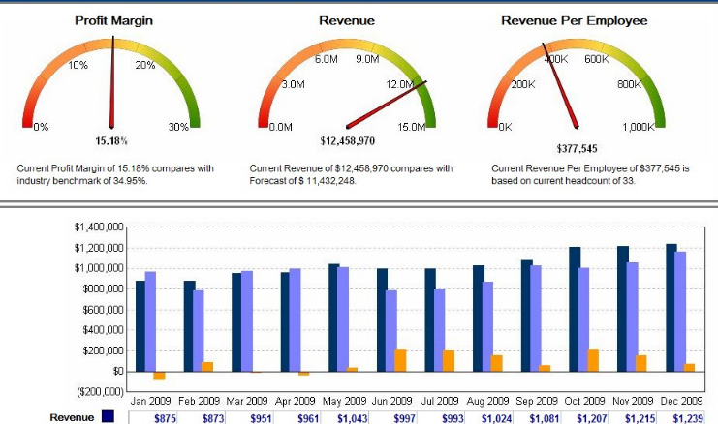
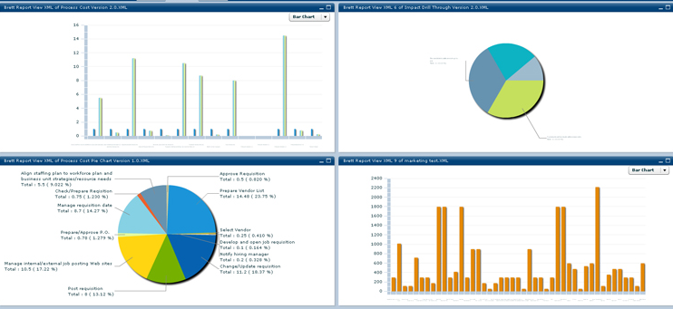
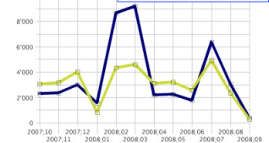
Visualization/Dashboards
Reports
Data repository
Different systems

Slide 23
Master Data Management
In business, master data Management, comprises the processes, governance, policies, standards and tools that consistently define and manage the critical data of an organization to provide a single point of reference. The data that is mastered may include:
Reference data– the business objects for transactions, and the dimensions for analysis
analytical data – supports decision making
In computing, a master data management tool can be used to remove duplicates, standardize data (mass maintaining), and incorporate rules to eliminate incorrect data from entering the system.

Slide 24
Master Data Management
Master data management has the objective of providing processes for collecting, aggregating, matching, consolidating, quality-assuring, persisting and distributing such data throughout an organization to ensure consistency and control in the ongoing operations as well as maintenance and application use of available information.

Slide 25
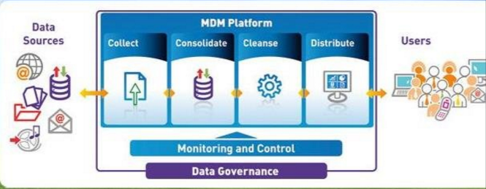
Master Data Management

Slide 26
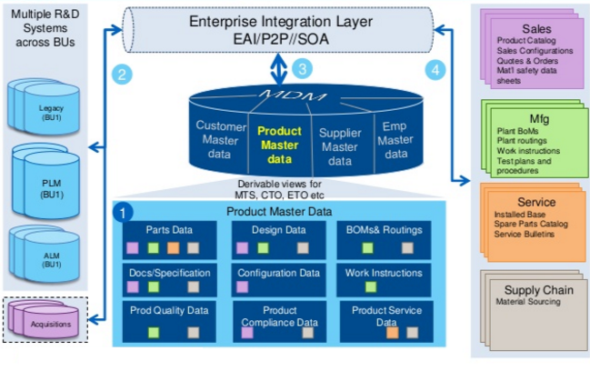
Product Master Data

Slide 27
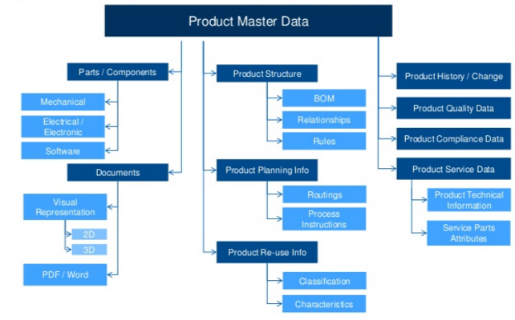
Product Master Data (Ontology)

Slide 28

The Cloud…
Cloud computing, often referred to as simply “the cloud,” is the delivery of on-demand computing resources—everything from applications to data centers—over the Internet on a pay-for-use basis.

Slide 29
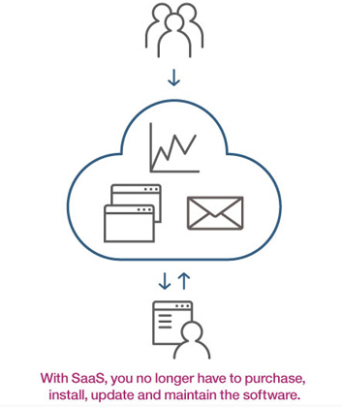
The Cloud…(SaaS)
Software as a service (SaaS) runs on distant computers “in the cloud” that are owned and operated by others and that connect to users’ computers via the Internet and, usually, a web browse

Slide 30
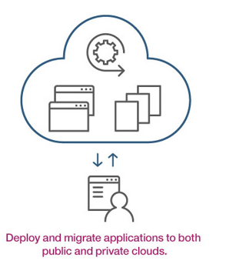
The Cloud… (PaaS)
Platform as a service (PaaS) provides a cloud-based environment with everything required to support the complete lifecycle of building and delivering web-based (cloud) applications—without the cost and complexity of buying and managing the underlying hardware, software, provisioning, and hosting.

Slide 31
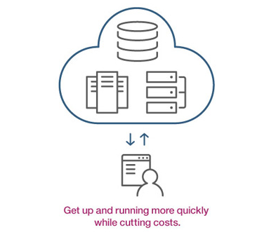
The Cloud… (IaaS)
Infrastructure as a service (IaaS) provides companies with computing resources including servers, networking, storage, and data center space on the cloud.

Slide 32
Mobile Systems…
A mobile operating system (or mobile OS) is an operating system for smartphones, tablets, or other mobile devices.
Mobile operating systems combine features of a personal computer operating system with other features useful for mobile or handheld use; usually including, and most of the following considered essential in modern mobile systems; a touchscreen, cellular, Bluetooth, Wi-Fi, GPS mobile navigation, camera, video camera, speech recognition, voice recorder, music player, near field communication and infrared blaster.

Slide 33
Artificial Intelligence…
Artificial intelligence (AI) is the intelligence exhibited by machines which mimic "cognitive" functions that humans associate with other human minds, such as "learning" and "problem solving".
AI research is divided into subfields that focus on specific problems or on specific approaches or on the use of a particular tool or towards satisfying particular applications.
The central problems (or goals) of AI research include reasoning, knowledge, planning, learning, natural language processing, perception and the ability to move and manipulate objects.

Slide 34
Artificial Intelligence…
Artificial Intelligence (AI) has often been popularly envisaged in super-smart humanoid robot form.
In fact, it's more commonly implemented as behind-the-scenes algorithms that can process 'big' data to accomplish a range of relatively mundane tasks far more efficiently than humans can.

Slide 35
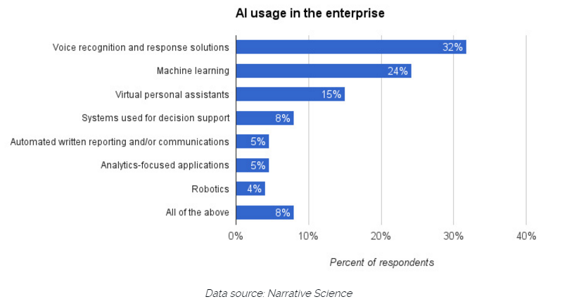
Use of Artificial Intelligence…

Slide 36
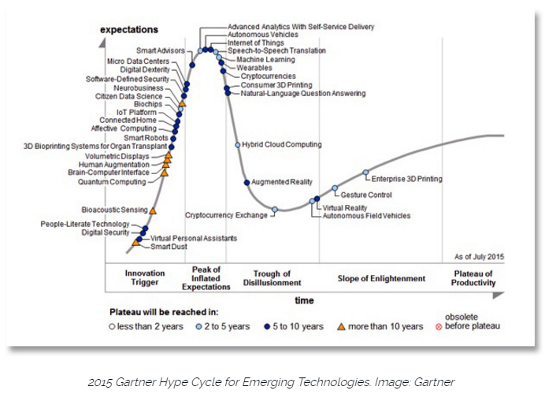

Slide 37
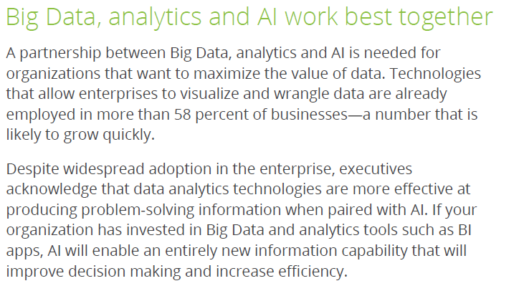

Slide 38
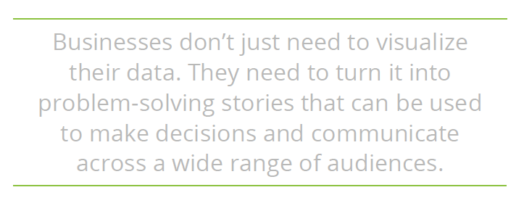

Slide 39
Successful Business Intelligence Implementation
Appropriate Planning and Alignment with the Business Strategy
Planning and execution components
Business
Organization
Functionality
Infrastructure
Define objectives while considering organization’s skills, plan for change, prepare action plan
Establish a BI Competency Center (BICC) within the Company
Support dissemination, training, and best practices

Slide 40
Major BI Trends
Mobile
Cloud
Social Media
Advanced Analytics
Advanced intelligence (AI integration)

Slide 41
Conclusion
Today’s organizations are deriving more value from BI by extending actionable information to many types of employees, maximizing the use of existing data assets
Visualization tools including dashboards are used by producers, retailers, governments, and special agencies
More and more industry-specific analytical tools will flood the market to perform almost any kind of analysis and to facilitate informed decision making from the top level to the user level

Slide 42
Conclusion…
Today;
BI is a kind of reporting tool on top of a data warehouse that includes historical progress of the enterprise
Tomorrow;
BI is expected to focus more on real-time events and predicting the main issues of the following days.

